Slide 1

Project Proposal
Humayun Ahmed
https://www.linkedin.com/in/humayunahmed/

Slide 2
Current Implementation
Client & Server-side implementations are separated
Monolithic application
Poor test coverage
Concurrency is not handled
Idempotency is not handled
All user cases are not handled
Short time delivery
Can be scaled by taking help of cloud, docker, Kubernetes

Slide 3
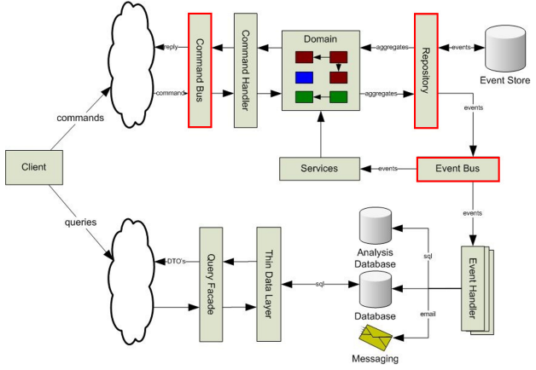
Proposed Scalable Architecture

